Slide 1
Lecture 6 Quine-McCluskey Method
A systematic simplification procedure to reduce a minterm expansion to a minimum sum of products.
Use XY + XY’ = X to eliminate as many as literals as possible.
The resulting terms = prime implicants.
Use a prime implicant chart to select a minimum set of prime implicants.

Slide 2
Determination of Prime Implicants
Eliminate literals
Two terms can be combined if they differ in exactly one variable.
AB’CD’ + AB’CD = AB’C
1 0 1 0 + 1 0 1 1 = 1 0 1
X Y X Y’ X
A’BC’D + A’BCD’ (won’t combine)
0 1 0 1 + 0 1 1 0 (check # of 1’s)
We need to compare and combine whenever possible.

Slide 3
Sorting to Reduce Comparisons
Sort into groups according to the number of 1’s.
F(a,b,c.d) = Σm(0,1,2,5,6,7,8,9,10,14)
No need for comparisons
(1) Terms in nonadjacent group
(2) Terms in the same group
Group 0 0 0000
Group 1 1 0001
2 0010
8 1000
Group 2 5 0101
6 0110
9 1001
10 1010
Group 3 7 0111
14 1110

Slide 4
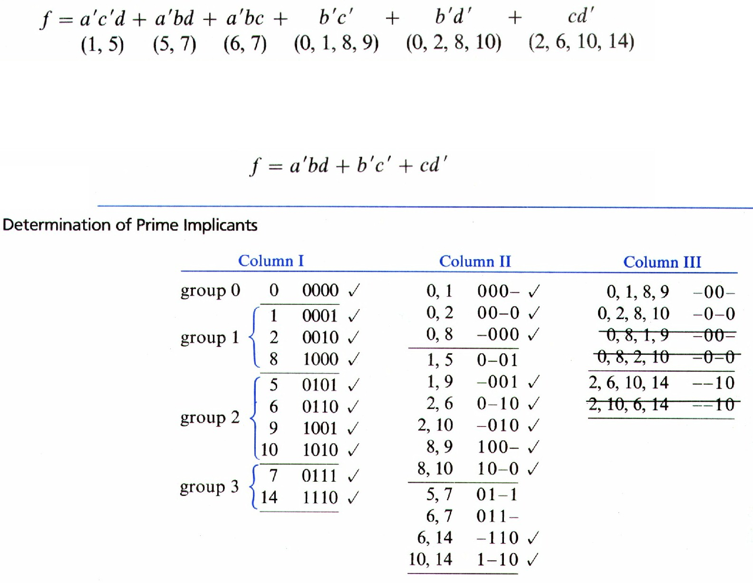
Comparison of adjacent groups
Use X + X = X repeatedly between adjacent groups
Those combined are checked off.
Combine terms that have the same dashes and differ one in the number of 1’s. (for column II and column III)

Slide 5
Prime Implicants
The terms that have not been checked off are called prime implicants.
f = 0-01 + 01-1+011- + -00-
+ -0-0 + --10
= a’c’d + a’bd + a’bc + b’c’ +
b’d’ + cd’
Each term has a minimum number of literals, but minimum SOP for f:
f = a’bd + b’c’ + cd’
(a’bd, cd’ => a’bc)
(a’bd, b’c’ => a’c’d)
(b’c’, cd’ => b’d’)

Slide 6
Definition of Implicant
Definition
Given a function of F of n variables, a product term P is an implicant of F iff for every combination of values of the n variables for which P = 1, F is also equal to 1.
Every minterm of F is an implicant of F.
Any term formed by combining two or more minterms is an implicant.
If F is written in SOP form, every product term is an implicant.
Example: f(a,b,c) = a’b’c’ + ab’c’ + ab’c + abc = b’c’ + ac
If a’b’c’ = 1, then F = 1, if ac = 1, then F = 1. a’b’c’ and ac are implicants.
If bc = 1, (but a = 0), F = 0, so bc is not an implicant of F.

Slide 7
Definition of Prime Implicant
Definition
A prime implicant of a function F is a product term implicant which is no longer an implicant if any literal is deleted from it.
Example: f(a,b,c) = a’b’c’ + ab’c’ + ab’c + abc = b’c’ + ac
Implicant a’b’c’ is not a prime implicant. Why? If a’ is deleted, b’c’ is still an implicant of F.
b’c’ and ac are prime implicants.
Each prime implicant of a function has a minimum number of literals that no more literals can be eliminated from it or by combining it with other terms.

Slide 8
Quine McClusky Procedure
QM procedure:
Find all product term implicants of a function
Combine non-prime implicants.
Remaining terms are prime implicants.
A minimum SOP expression consists of a sum of some (not necessarily all) of the prime implicants of that function.
We need to select a minimum set of prime implicants.
If an SOP expression contains a term which is not a prime implicant, the SOP cannot be minimum.

Slide 9
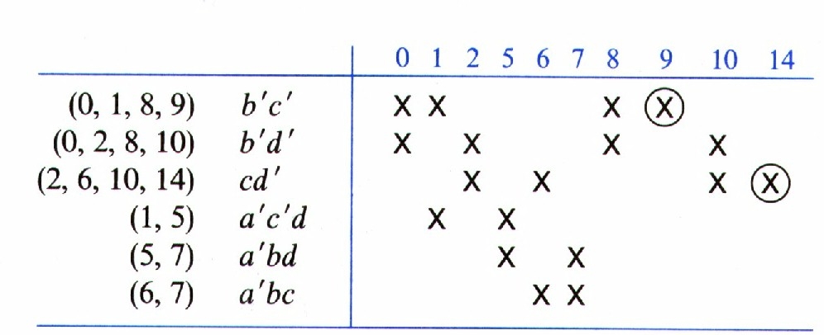
Prime Implicant Chart
Chart layout
Top row lists minterms of the function
All prime implicants are listed on the left side.
Place x into the chart according to the minterms that form the corresponding prime implicant.
Essential prime implicant
If a minterm is covered only by one prime implicant, that prime implicant is called essential prime implicant. (9 & 14).
Essential prime implicant must be included in the minimum sum of the function.

Slide 10
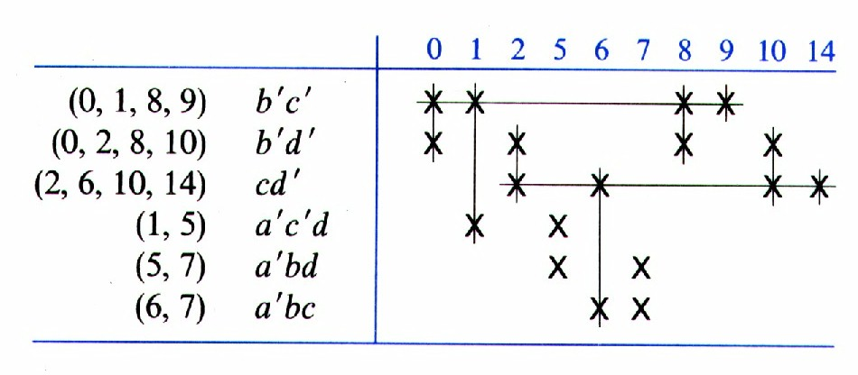
Selection of Prime Implicants
Cross out the row of the selected essential prime implicants
The columns which correspond to the minterms covered by the selected prime implicants are also crossed out.
Select a prime implicant that covers the remaining columns. This prime implicant is not essential.

Slide 11
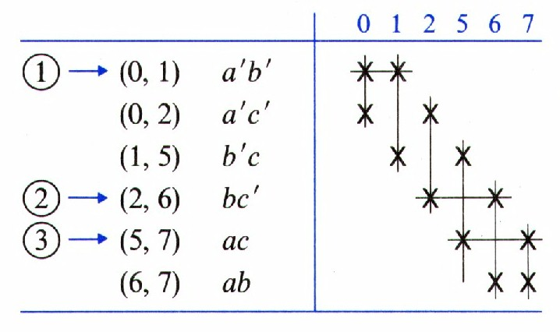
A Cyclic Prime Implicant Chart
Two or more X’s in every column.
F = Σm(0,1,2,5,6,7)
F = a’b’ + bc’ + ac. (by try and error). No guarantee for this to be minimum.
0 000
1 001
2 010
5 101
6 110
7 111
All checked
off
0,1 00-
0,2 0-0
1,5 -01
2,6 -10
5,7 1-1
6,7 11-

Slide 12
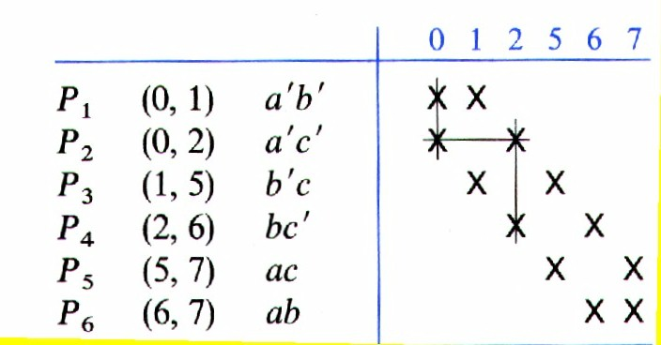
Another Solution
F = a’c’ + b’c + ab
Each minterm is covered by two different prime implicants.

Slide 13
Petrick’s Method
A more systematic way to find all minimum solutions from a prime implicant chart.
P is True when all the minterms in the chart have been covered. P = f (P₁, P₂, …)
Label each row with P_{i}.
P_{i} is true when the prime implicant in row P_{i} is included in the solution.
For column 0, we must choose either P₁ or P₂ in order to cover minterm 0. Thus (P₁ + P₂) must be true.

Slide 14
Petrick’s Method (cont.)
For column 0, we must choose either P₁ or P₂ in order to cover minterm 0. Thus (P₁ + P₂) must be true.
To cover minterm 1, P₁ + P₃ must be true, and etc.
P = (P₁+P₂)(P₁+P₃)(P₂+P₄)(P₃+P₅)(P₄+P₆)(P₅+P₆) = 1
This means: We must choose row P₁ or P₂, and row P₁ or P₃, and row P₂ or P₄, etc.

Slide 15
Petrick’s Method (cont.)
Then we simplify
P = (P₁+P₂)(P₁+P₃)(P₂+P₄)(P₃+P₅)(P₄+P₆)(P₅+P₆)
= (P₁ + P₂P₃)(P₄ + P₂P₆)( (P₅ +P₃P₆);
(X+Y)(X+Z) = X +YZ)
= (P₁P₄+ P₁P₂P₆ + P₂P₃P₄ + P₂P₃P₆)(P₅ + P₃P₆)
= P₁P₄P₅ + P₁P₂P₅P₆ + P₂P₃P₄P₅ + P₁P₃P₄P₆ + P₂P₃P₆
In other words, for P = 1 (to cover all minterms), we must choose row P₁ and P₄ and P₅ or row P₁and P₂ and P₅ and P₆ or etc ….
There are five to choose. We choose P₁P₄P₅ or P₂P₃P_{6.}

Slide 16
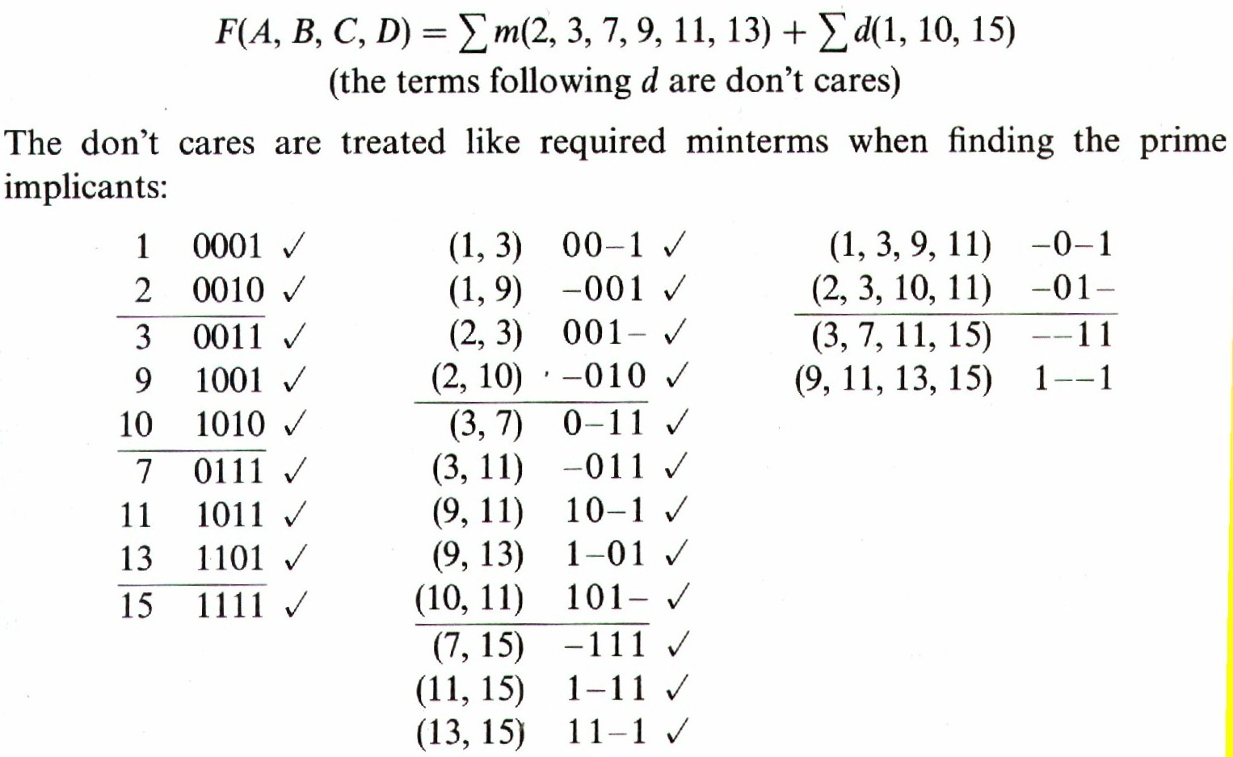
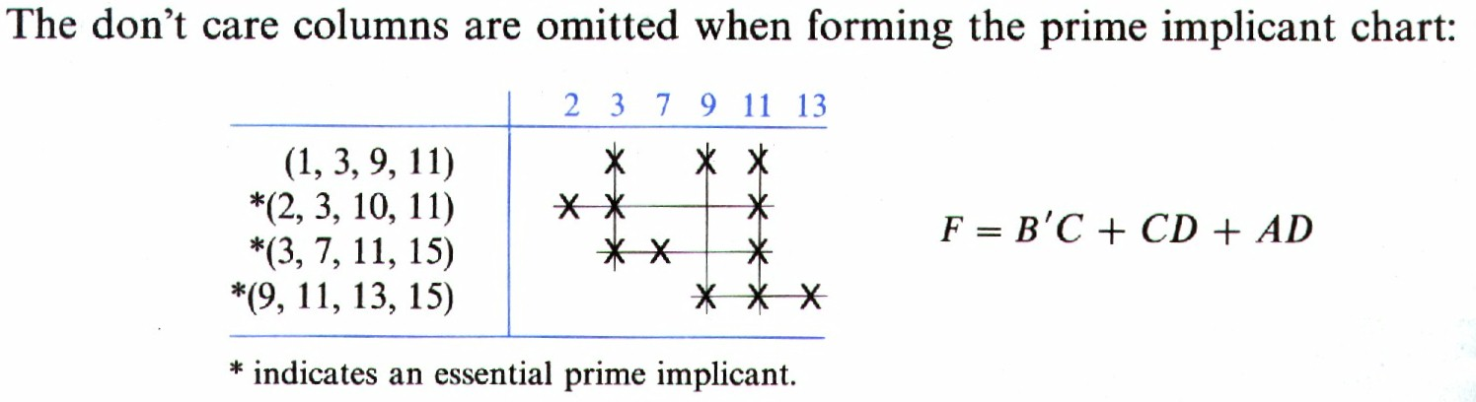
Simplification of Incompletely Specified Functions
An incompletely specified function

Slide 17
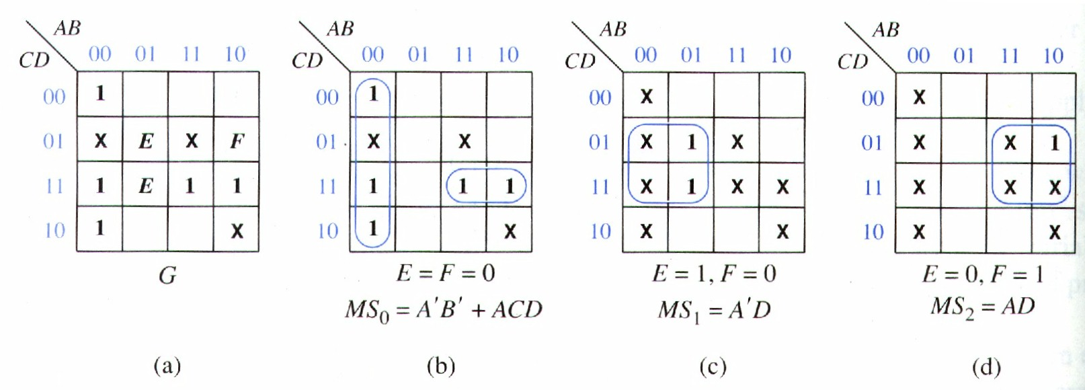
Simplification Using Map-Entered Variables
Extend K-map for more variables.
When E appears in a square, if E = 1, then the corresponding minterm is present in the function G.
G (A,B,C,D,E,F) = m₀ + m₂ + m₃ + Em₅ + Em₇+ Fm₉ + m₁₁ + m₁₅ + (don’t care terms)

Slide 18
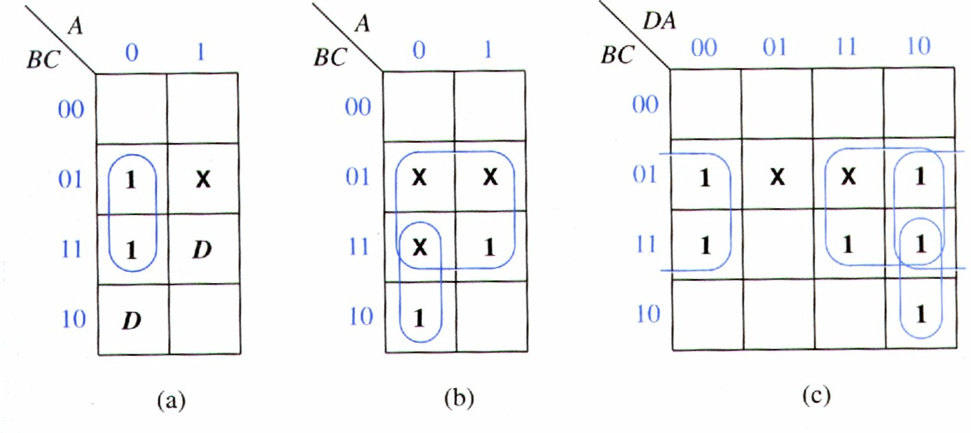
Map-Entered Variable
F(A,B,C,D) = A’B’C + A’BC + A’BC’D + ABCD + (AB’C), (don’t care)
Choose D as a map-entered variable.
When D = 0, F = A’C (Fig. a)
When D = 1, F = C + A’B (Fig. b)
two 1’s are changed to x’s since they are covered in Fig. a.
F = A’C + D(C+A’B) = A’C + CD + A’BD

Slide 19
General View for Map-Entered Variable Method
Given a map with variables P₁, P₂ etc, entered into some of the squares, the minimum SOP form of F is as follows:
F = MS₀ + P₁ MS₁ + P₂MS₂ + … where
MS₀ is minimum sum obtained by setting P₁ = P₂ .. =0
MS₁ is minimum sum obtained by setting P₁ = 1, P_{j} = 0 (j ≠ 1), and replacing all 1’s on the map with don’t cares.
Previously, G = A’B’ + ACD + EA’D + FAD.

